Slide 1
PMP & PIP
Segmentation Rating | Description
A | Meet > 60% for both product
B | Meet 41% - 60% for both product
C | Meet > 41% for either product
D | Meet 6% - 40% for either product
E | Meet < 5% for both product
Note:
PF target refers to PF disbursed (RM) target.
CC target refer to CC approval (#) target.

Slide 2
PMP & PIP
Segmentation Rating | Description
A | Meet > 60% for both product | 19 | 9.9%
B | Meet 41% - 60% for both product | 4 | 2.1%
C | Meet > 41% for either product | 47+31 =78 | 40.6
D | Meet 6% - 40% for either product | 44 | 22.92%
E | Meet < 5% for both product | 47 | 24.48%
Total CRO : 192 sales staffs

Slide 3
Mechanics – PMP & PIP
Segmentation Rating | Action Taken
A | A letter to congratulate sales staff on his/ her consistent performance. (PMP)
B | A letter to congratulate sales staff on his/ her consistent performance. (PMP)
C | A letter of explanation (LOE) to sales staff which demand the sales staff to revert on the subsequent action plan to improve his/ her sales performance. (PIP)
D | A letter of explanation (LOE) to sales staff which demand the sales staff to revert on the subsequent action plan to improve his/ her sales performance. (PIP)
E | A LOE & final warning letter to sales staff which notify the non-performance for the next subsequent month, the company have the rights to terminate him / her.
Sales Staff Measurement (Phase I)
The measurement of sales staff performance based on 3 consecutive months performance. (Refer appendix I)
Staff will be terminated in the event there are ‘C’ ratings for 4 consecutive months.
Staff will be terminated in the event there are ‘D’ ratings or lower for 3 consecutive months.
Staff will be terminated in the event there are ‘E’ ratings for consecutive 2 months.
Note: CCG management may time from time review and change the segmentation rating criteria if it deems necessary based on the business needs.

Slide 4
Mechanics (cont’d) – PMP & PIP
Segmentation Rating | Action Taken
A | A letter to congratulate CSU Head on his/ her consistent performance. (PMP)
B | A letter to congratulate CSU Head on his/ her consistent performance. (PMP)
C | A letter of explanation (LOE) to CSU Head which demand the sales staff to revert on the subsequent action plan to improve his/ her sales performance. (PIP)
D | A letter of explanation (LOE) to CSU Head which demand the sales staff to revert on the subsequent action plan to improve his/ her sales performance. (PIP)
E | A LOE & final warning letter to CSU Head which notify the non-performance for the next subsequent month, the company have the rights to terminate him / her.
CSU Unit Head Measurement
The measurement of CSU Head will be based on continuous 4 months performance. (Refer appendix II)
CSU Head be terminated in the event there are ‘D’ ratings or lower for consecutive 4 months.
CSU Head will be terminated in the event there are ‘C’ ratings for consecutive 5 months.
CSU Head will be terminated in the event there are ‘E’ ratings for consecutive 3 months.
Note :CCG management may time from time review and change the segmentation rating criteria if it deems necessary based on the business needs.

Slide 5
PMP & PIP Appendix

Slide 6
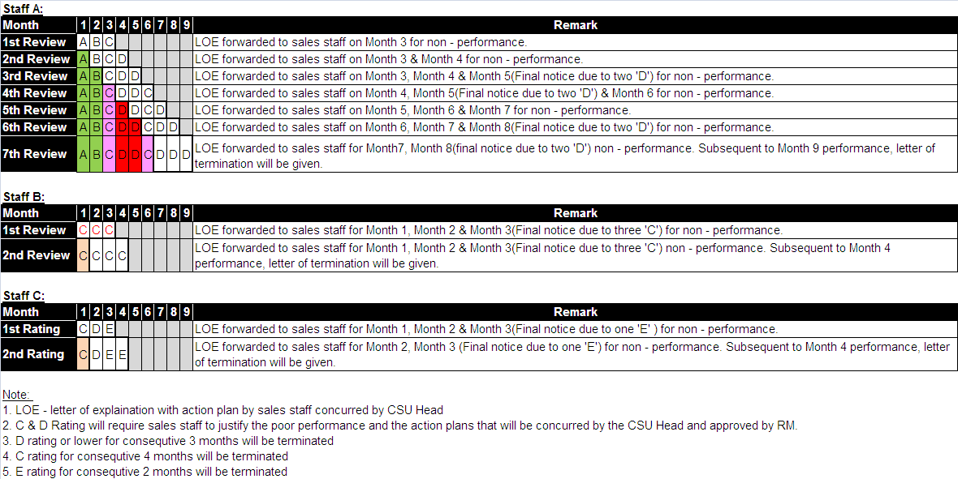
PMP & PIP - Appendix I

Slide 7
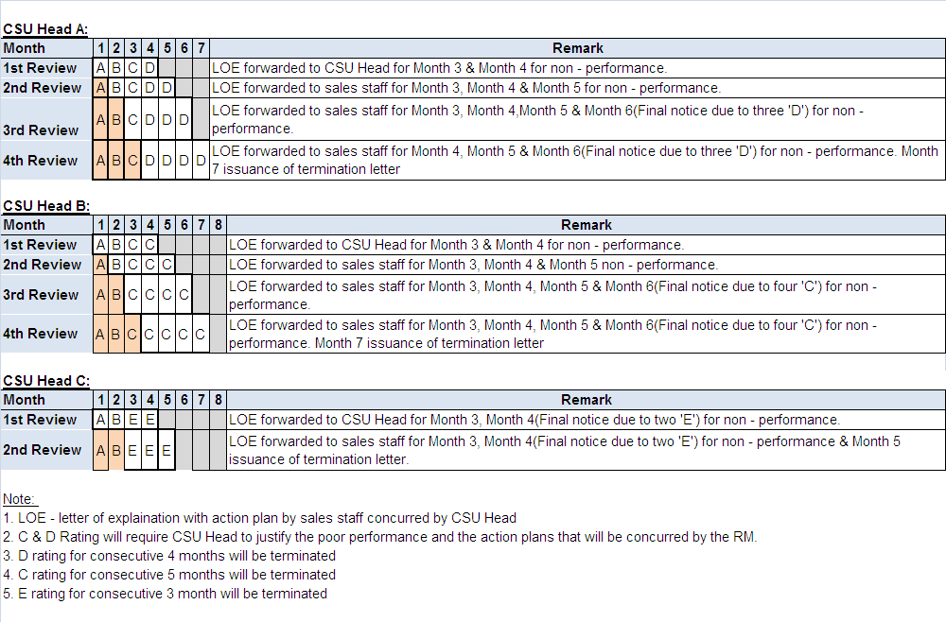
PMP & PIP - Appendix II

